Slide 1
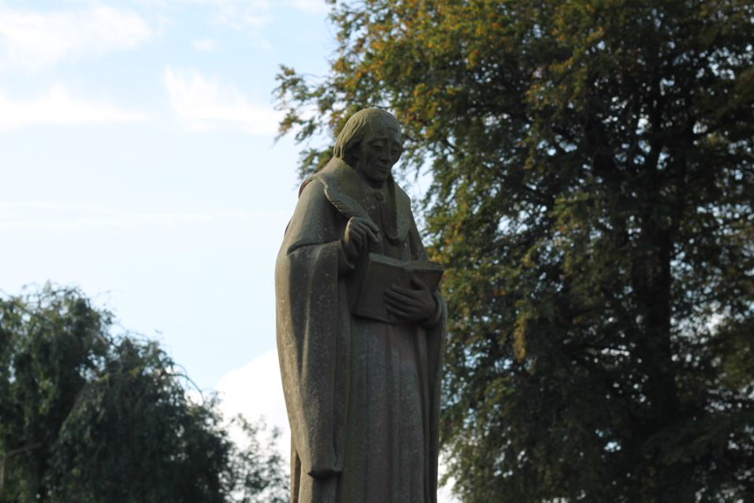

Office Administrator
Required from April 2026
Saint Bede's Catholic High School,
Talbot Road,
Lytham St Annes,
Lancashire,
FY8 4JL.
01253 737174
hr@stbedeslytham.lancs.sch.uk
www.stbedeslytham.lancs.sch.uk

Slide 2
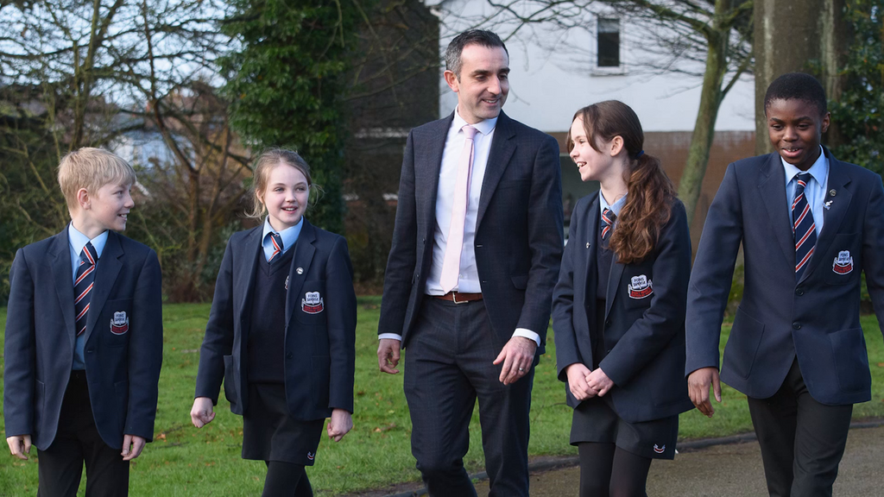
Headteacher’s Welcome
Thank you for expressing an interest in applying for a role at Saint Bede’s Catholic High School, Lytham. As a Catholic school within the Diocese of Lancaster, our ethos of ‘Being a Bede’ encapsulates what we believe we are all about as a school community. We are a family, in which each child in our care is supported and challenged to make the very most of their God-given potential and to be the best that they can be in every aspect of their personal, spiritual, and academic development.
Our expectations regarding behaviour, uniform, and respect towards others are unapologetically high. Our pupils are proud to ‘Be a Bede’ and, in turn, we are proud of them and their achievements. Visitors to the school frequently comment on the calm and caring atmosphere they experience, and the warm welcome they receive from pupils and staff alike.
“At Saint Bede’s Catholic High School, pupils clearly feel part of a community where they are valued as unique individuals. They readily bear witness to the ways in which they are supported and cared for by senior leaders, the whole staff team, and each other. They appreciate the distinctive Catholic nature of their school, speak warmly of it, and value being part of the St Bede’s family.” Catholic Schools Inspection – March 2023
We are seeking to appoint enthusiastic and committed professionals to join our school community and contribute to the high standards and inclusive provision for which Saint Bede’s is known. Staff at all levels work collaboratively to ensure that barriers to learning are removed and that every pupil is supported to achieve their full potential. We value creativity, dedication, and a shared commitment to delivering an excellent educational experience for all.
Potential candidates are very welcome to visit our school to meet our pupils and staff and to experience first-hand the strong sense of community that defines Saint Bede’s.
We look forward to receiving your application.
Yours sincerely,
Mr P Marsden
Headteacher
“We aim to reflect the true Christian Values proclaimed in the Gospel, and seek to provide a caring community in which young people can grow as balanced individuals, morally, intellectually and spiritually and so participate fully in the real world”.

Slide 3
KEY INFORMATION
Post Title: Office Administrator (School Admin Officer 3 LCC profile)
Salary: LCC Support Staff Pay Scale Grade 5
Responsible to: School Business Manager
Hours: TTO plus 5 days, 37 hours a week (exact hours to be agreed)
Start Date: April 2026
Saint Bede’s Catholic High School is a thriving Catholic secondary school dedicated to nurturing the academic, spiritual, and personal development of every child. Guided by Gospel values and our ethos of 'Being a Bede', we foster a community of love, faith, learning, and service, where all are encouraged to grow in character and excellence.
MAIN PURPOSE OF THE ROLE
This is an exciting opportunity to join the operational/business function of the school, which includes finance, human resources, governance, events, communications, administration, and site management. Working under the supervision of and line managed by the School Business Manager, the successful candidate will provide a wide range of administrative services in providing support to SLT and the existing administrative function of school to assist in ensuring the day-to-day activities run efficiently and effectively.
The role requires excellent communication skills and the ability to respond professionally to parents, pupils, staff, external agencies and visitors.
Within the role, as Reprographics Assistant the job holder will be responsible for managing all reprographics requirements across school and, as Reception Cover, will deal with all aspects of enquiries received via the Reception function.
You must be able to operate sensitively, whilst being able to handle confidential issues. The successful candidate will be a proactive and positive person who works well in a team and has the ability to liaise well with all staff and governors within school.
This post is full time 37 hours per week, term time only plus 5 INSET Days, and the working hours are Monday to Friday approximately 8.30am-4.30pm with 30 minute unpaid lunch (until 4.00pm on a Friday).
Please note that in line with Keeping Children Safe in Education 2025, an online search will be carried out as part of our due diligence on shortlisted candidates.
This position is term time only, please note the salary quoted is full time equivalent. If successful, the salary received will be paid on a pro–rata basis.
Safeguarding
Saint Bede’s Catholic High School is committed to safeguarding and promoting the welfare of children and young people and expects all staff to share this commitment. Appointment to this post is subject to an enhanced DBS check and satisfactory references.

Slide 4
KEY RESPONSIBILITIES
Provide administrative support to SLT and other senior staff
Be a point of contact for parents/carers when covering Reception (break/lunch)
Assist in co-ordinating school functions, visits, events and all associated arrangements.
Supporting the functions/administration of the school office, including Reception duties.
Undertake appropriate continuing professional development and training commensurate with the role.
Reprographics support for all staff, ensuring that all printing/finishing is presented correctly and completed within agreed timescales.
Maintaining stock and ordering admin supplies.
To manage First Aid across school and administer first aid when required.
EVC co-ordination for trips
ROLE SUMMARY
The role is an important one in assisting me with the effective running of school. We require a flexible and committed individual to join the team to grow our effective administrative support. This role requires a friendly, efficient, enthusiastic and organised approach to all tasks. Having prior school experience is not a pre-requisite for this role. We are simply looking for the right individual with the right skills, personality and abilities to join our small friendly team.
Mrs P Mercer, School Business Manager
PERSON SPECIFICATION
Essential:
Experience in roles providing excellent personnel, verbal and written communication skills.
Experience in planning ahead to support school’s wider needs.
Ability to perform effectively under pressure with strong multitasking skills in managing conflicting priorities effectively.
Ability to work collaboratively as part of a team, with a clear understanding of school roles, responsibilities, and your own position within the structure.
Proven ability to maintain confidentiality and exercise discretion at all times.
Commitment to safeguarding and promoting the welfare of children.
Proficient in the use of Microsoft IT packages (SIMS preferable but not essential).
Desirable:
A flexible and adaptable approach to working hours and responsibilities to meet the evolving needs of the school.
Willingness to contribute to extra-curricular activities.

Slide 5
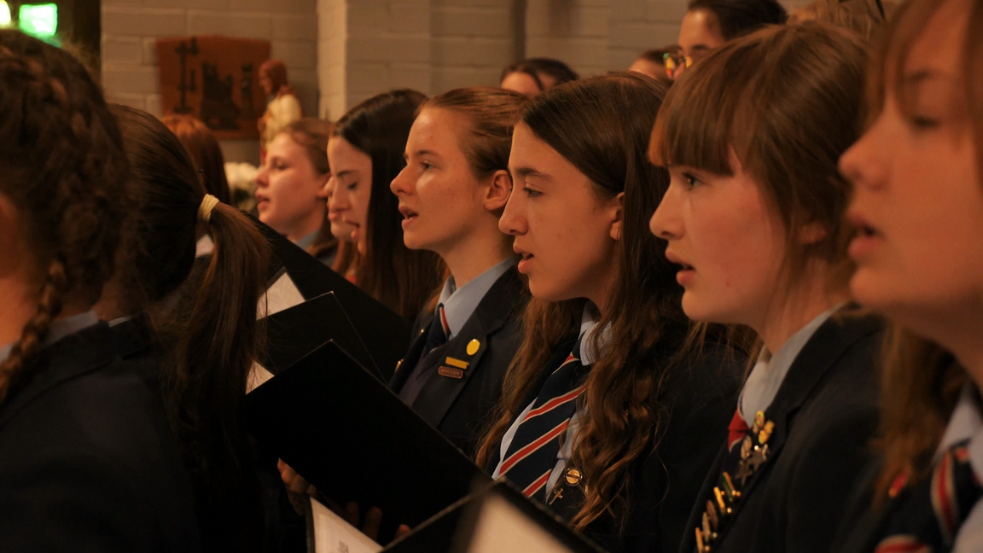
HOW TO APPLY
To apply, please submit the CES Application Form and the supporting recruitment documents provided. These documents are also available from the school website. Your supporting statement should be completed within the application form, using Calibri or Arial font, size 11, and must be no more than two pages in length.
Completed applications should be returned either by email or post to:
By email: hr@stbedeslytham.lancs.sch.uk
By post: Mrs P Mercer, School Business Manager
Saint Bede’s Catholic High School
Talbot Road
Lytham St Annes
Lancashire
FY8 4JL
Prospective candidates are warmly encouraged to visit the school prior to submitting an application.
To arrange a visit, please contact Mrs Mercer, School Business Manager, on 01253 737174 or via email at hr@stbedeslytham.lancs.sch.uk
CLOSING DATE FOR APPLICATIONS
The closing date for applications is Monday 23rd March 2026 at 12noon.
“We aim to reflect the true Christian Values proclaimed in the Gospel, and seek to provide a caring community in which young people can grow as balanced individuals, morally, intellectually and spiritually and so participate fully in the real world”.

